Slide 1
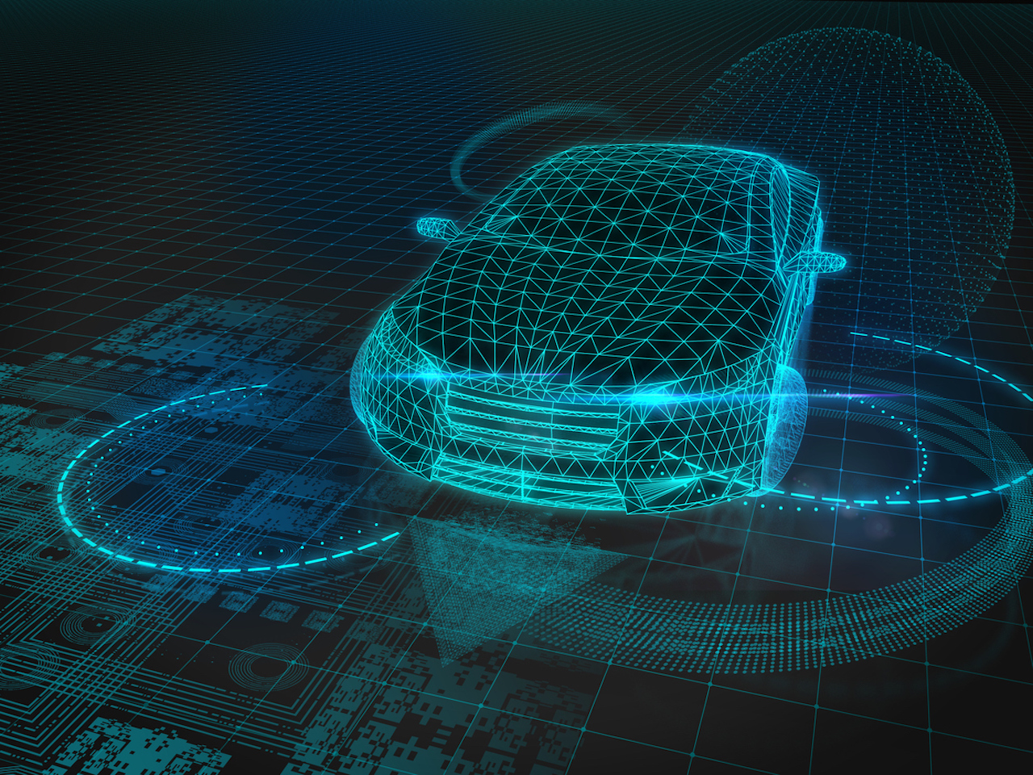
STEERING WHEEL ANGLE PREDICTION
IN SELF DRIVING CARS

Slide 2
INTRODUCTION
-> Based on the latest statistics, the reason for major fatal road accident were due to over speeding, driver fatigue and other distractions etc.
-> These problems can be overcome with the help of autonomous cars.
-> As the cars become more automated, road fatalities can be controlled.
-> With the application of Deep Learning(CNN), cars can drive autonomously without the human intervention.

Slide 3
PROJECT OBJECTIVE
-> While building an autonomous cars, these are some of the factors to be considered,
> Steering Wheel Angle > Acceleration system > Braking system
-> Our primary objective is about predicting the steering wheel angle of the car.

Slide 4
SOFTWARE AND HARDWARE REQUIREMENTS
SOFTWARE REQUIREMENTS
OS : GNU/Linux, Windows 10,8.1
Programming
Language : Python3
Framework : Pytorch/ TensorFlow
Training
Platform : Google Colabs/ Kaggle
HARDWARE REQUIREMENTS
GPU : 12GB NVIDIA Tesla K80 GPU
Processor : Intel Core i5-7200U (7th Gen)
Ram : 8GB
Memory : 1TB HDD

Slide 5
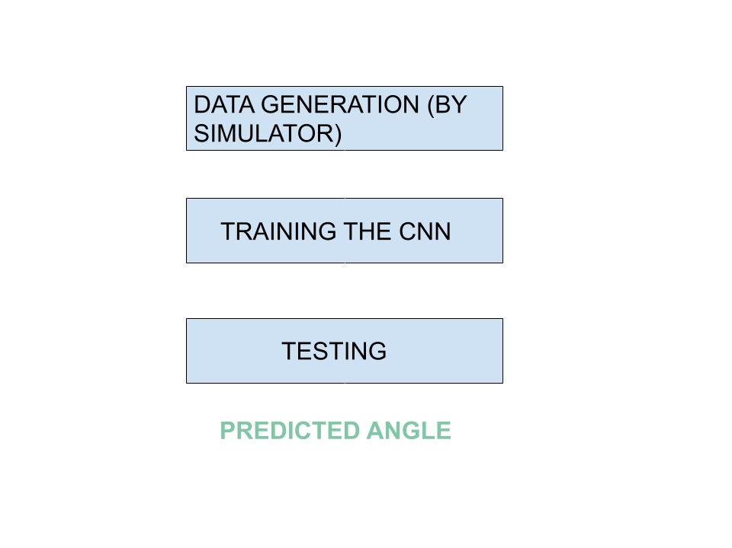
WORKFLOW

Slide 6
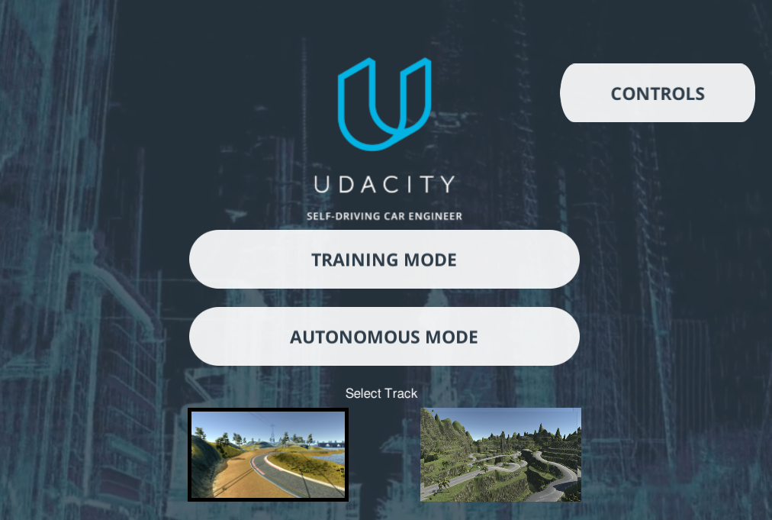
DATA GENERATION USING A SIMULATOR
Dataset generated by manual driving.
Car driven without human intervention
Medium Level
Hard Level

Slide 7
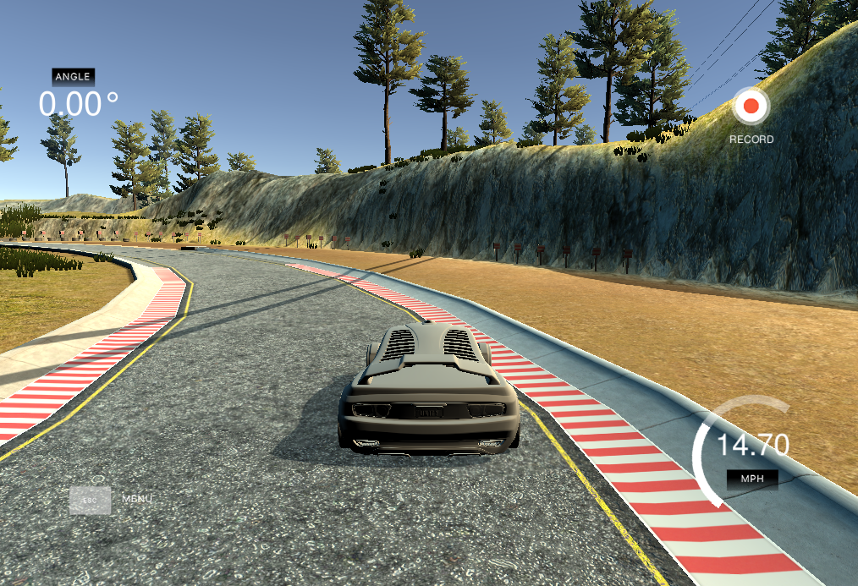
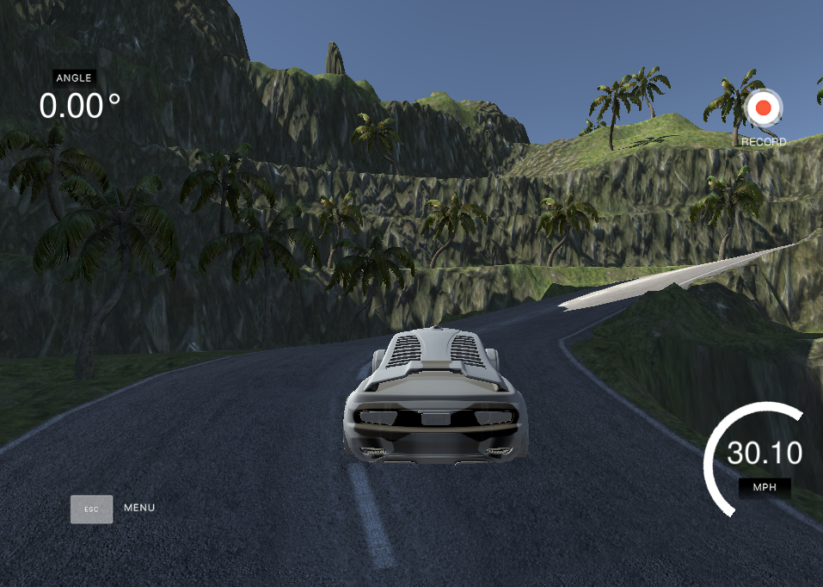
TWO VARIANTS OF DATA GENERATION
MEDIUM
HARD

Slide 8
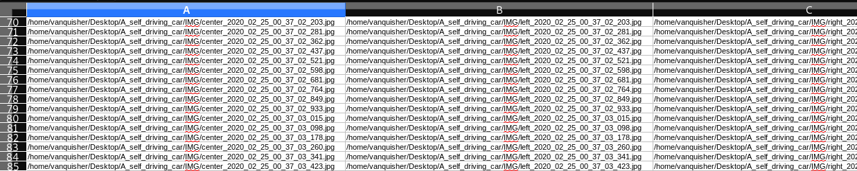
GENERATED DATASET
Path of Center camera image.
Path of left camera image.
Path of right camera image.

Slide 9

GENERATED DATASET CONTD.
Speed
Reduced
Steering angle
Throttle
Brake

Slide 10
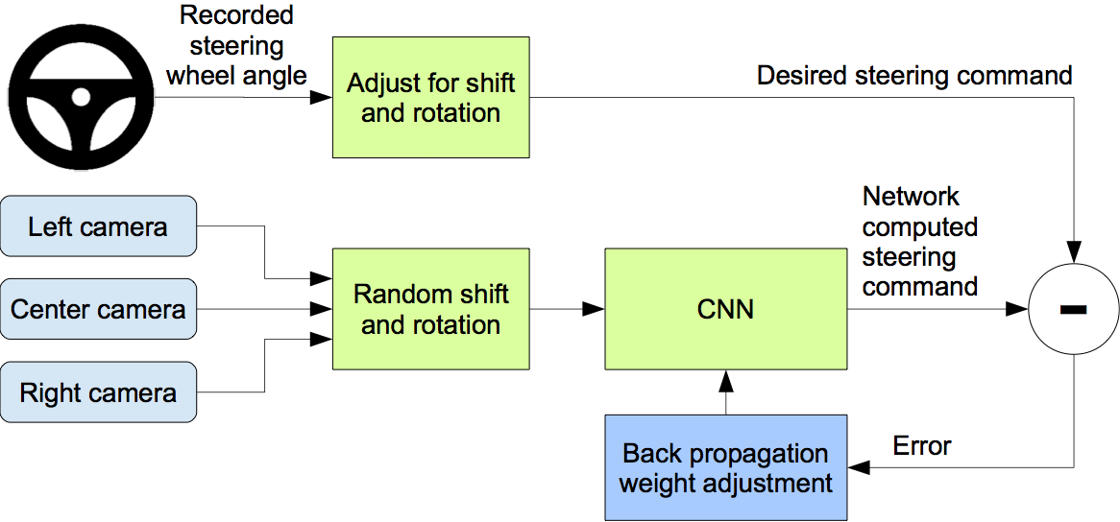
PROJECT OVERVIEW
High level overview of the project

Slide 11
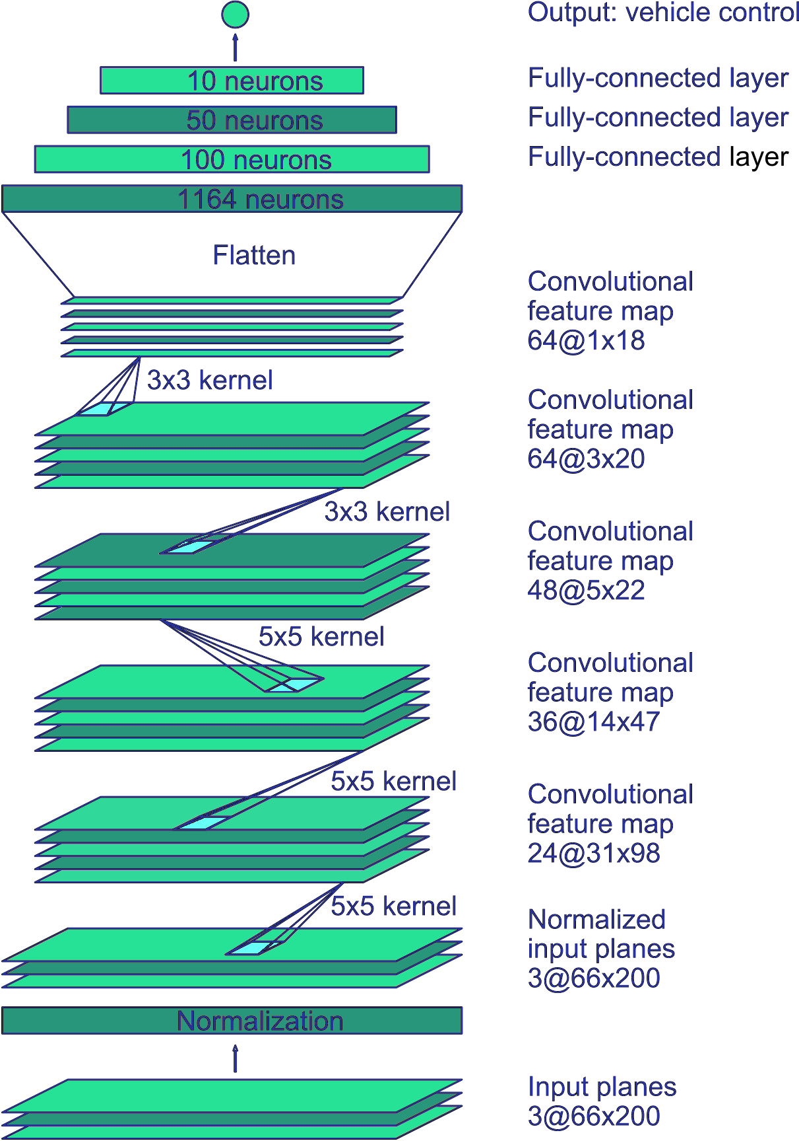
CNN
3 FCL for Classification
9 layered Convolutional Neural Network
5 Convolutional Layers for Feature extraction
1 Normalization Layer

Slide 12
TEAM A11
KIRAN U KAMATH
DHANUSH B RAJ
MEGHANA GS
PRAJWAL T

Slide 13
THANK YOU

